Slide 1
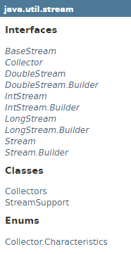
Java 8 Stream
Java 8 has introduced a package java.util.stream that consists the classes that supports functional-style operations on streams of elements.
The basic classes of this package are Stream for objects and IntStream, LongStream, DoubleStream for primitive data type integer, long and double respectively.

Slide 2
Java 8 Stream
java.util.stream.Stream is an interface which represents a sequence of elements. It supports sequential and aggregate operations. The computation operations are composed into stream pipeline which consists a source, intermediate operations and a terminal operation.
Streams are lazy and the operations on streams are performed only when terminal operation is initiated and source elements are consumed only if needed.
In most of the stream operations we need to pass lambda expression that must be non-interfering and stateless. Non-interfering means that computational operations do not modify source stream and being stateless means that result should not depend on any state that can change in stream pipeline execution. The parameter passed in stream operation could be an instance of
java 8 Function or a lambda expression.
While invoking intermediate or terminal operation, stream should be operated on only once and if it is being reused then it will throw IllegalStateException.
Streams implement AutoCloseable and need not to close after use but if stream source is IO channel then we need to close it.
Streams are backed by collections, arrays or generating functions. Streams can execute either sequentially or in parallel and this choice is made while initially creating streams.

Slide 3
Java 8 Stream
https://docs.oracle.com/javase/8/docs/api/java/util/stream/Stream.html

